Slide 1

Reconstructing a two-vowel system in Proto-Coptic
Marwan Kilani

Slide 2
Coptic Vowels - Overview
• Coptic is a group of related dialects, not a single language. Sahidic and Bohairic are best attested; others are less documented. Vowels differ among dialects but their correspondences are generally well understood.
• In general, only the stressed vowel is distinctive and can be reconstructed – unstressed vowels are merged and reduced to ⲁ |a| or ⲉ possibly standing for |ə|
• However, the stress pattern can move between prosodic forms, revealing different vowels of the word
e.g. Absolute [S] ⲟⲩⲟⲥⲧⲛ |wɔ́stᵊn| but Prepronominal [S] ⲟⲩⲉⲥⲑⲱⲛ⸗ |wəstón|
• Contextual allophones are known, e.g. ⲱ |ó| > ⲟⲩ |ú| after nasal consonants (in most if not all dialects)
• The distribution of stressed vowels is restricted by the historical shape of the syllables in which they appear. The result is a series of syllable-conditioned allophones
ⲥⲱⲧⲡ |sotᵊp| CV́.CVC | 'to choose'
ⲥⲟⲧⲡ⸗ϥ |sɔtpᵊf| CV́C.CVC | 'to choose him'
CV́C | CV́
ⲟ |ɔ| | ⲱ |o|
ⲁ |a| | ⲏ |e| / ⲓ |i|

Slide 3
Proto-Coptic vowels
Current model: 3 vowels *a, *i, *u at the Egyptian/Proto-Coptic level
CVC | Proto-Vowel | CV
ⲟ |ɔ| | *a | ⲱ |o|
ⲁ |a| | *i | ⲓ |i|
 | *u | ⲏ |e|
?
Unclear Cond.
My model: 2 proto-Coptic vowels *a, *E ( = non-*a )
CVC | Proto-Vowel | CV
ⲟ |ɔ| | *a | ⲱ |o|
ⲁ |a| | *E | ⲓ |i|
 |  | ⲏ |e|
→ ⲓ |i| / _.E
→ ⲏ |e| / _.a
(possibly others)

Slide 4
Proto-Coptic vowels: why do we need a new model?
Current model: 3 vowels *a, *i, *u at the Egyptian/Proto-Coptic level
CVC | Proto-Vowel | CV
ⲟ |ɔ| | *a | ⲱ |o|
ⲁ |a| | *i | ⲓ |i|
 | *u | ⲏ |e|
?
Unclear Cond.
Practical problems
Conceptual problems
No one has been able to suggest a coherent, comprehensive set of rules to distinguish between *i and *u on the basis of the Coptic evidence
The three-vowel system is not based on observation, but from the assumption that Egyptian must have had a Semitic-like vocalic system with 3 vowels

Slide 5
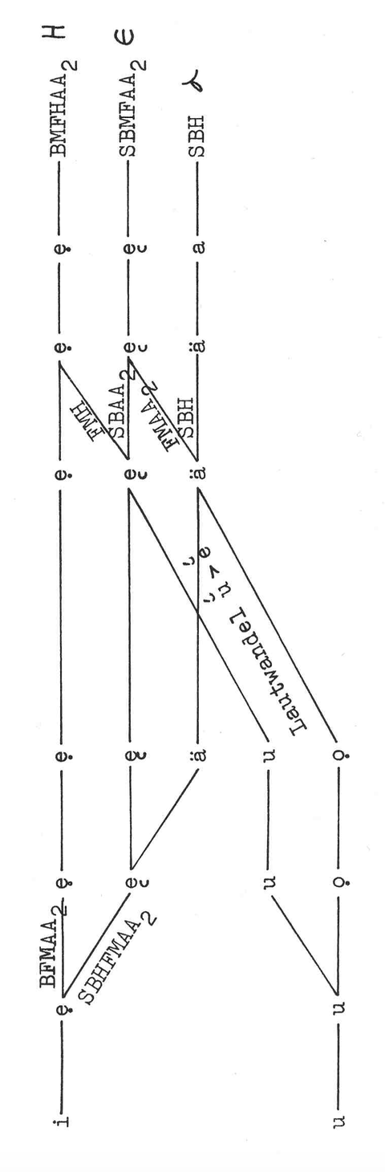

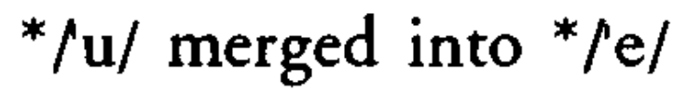
Current Model: the problem of *i vs *u
In closed syllables
Supporters of the current model generally agree that *i and *u merged in closed syllables.
There have been attempts to interpret apparent allophonic variants between ⲁ |á| and ⲉ |ɛ́| as reflecting originally distinct protovowels, but no coherent, predictive model has been suggested.
Loprieno 1995, 39
Osing 1976, 18

Slide 6
Current Model: the problem of *i vs *u
In open syllables
- Current models link ⲓ /i/ and ⲏ /e/ to Proto-Coptic vowels *i and *u.
- Scholars have turned to cuneiform transcriptions and Semitic loanwords to test this idea.
- However, the evidence is inconclusive: both Akkdian/Semitic i and u appear to correspond to both Coptic vowels.
*u → ⲏ |e| : e.g. ϭⲓⲛⲏⲣ |kʲinérə| < Sem. *kinurV
*u → ⲓ |i| : e.g. ⲧⲣⲓⲣ |tᵊrír| < Sem. *tVrurV
*i → ⲓ |i| : e.g. ⲯⲓⲧ |pᵊsít(ᵊ)| = cuneiform pi/e-ši-iṭ
*i → ⲏ |e| : e.g. ⲣⲏ |re| = cuneiform -ri-a
Suggested solution
Issues with these solutions
Ad hoc, non-systematic "rules" to explain the exceptions, based on nearby consonants.
E.g.:
*u → ⲏ but *u → ⲓ |i| before *r (Osing 1976, 19)
These "rules" are easily disproved by the data, e.g.:
ϭⲓⲛⲏⲣ |kʲinérə| < Sem. *kinurV
Also: pseudopart have always ⲏ - e.g. ⲥⲏⲣ+ |sér|

Slide 7
Why reconstructing 3 vowels in the first place?
It all goes back to an early 20th century assumption...
Sethe 1923, in one of the first articles discussing pre-Coptic vowels:
“…auf den Urzustand des ägyptischen Vokalismus gekommen sind, auf den Zustand, wie er bei der Abzweigung des Ägyptischen von dem semitischen Sprachstamm herrschte,…”
Proto-Semitic
3 vowels
• Egyptian is a semitic language
• Proto-Semitic is reconstructed with 3 vowels
➤ Therefore the Egyptian vocalic system must ultimately go back to a Semitic-like 3-vowel system
Egyptian /
Coptic
Semitic
Languages

Slide 8
Why reconstructing 3 vowels in the first place?
It all goes back to an early 20th century assumption...
Sethe 1923, in the first article discussing pre-Coptic vowels:
“…auf den Urzustand des ägyptischen Vokalismus gekommen sind, auf den Zustand, wie er bei der Abzweigung des Ägyptischen von dem semitischen Sprachstamm herrschte,…”
Proto-Semitic
3 vowels
• Egyptian is a semitic language
• Proto-Semitic is reconstructed with 3 vowels
➤ Therefore the Egyptian vocalic system must ultimately go back to a Semitic-like 3-vowel system
Egyptian /
Coptic
Semitic
Languages

Slide 9
But Egyptian is not Semitic!
Proto-Afro-Asiatic
P-Berber
P-Semitic
P-Eg-Cpt
P-Chadic
P-Cushitic
P-Omotic
Proto-Semitic : 3 vowels
Proto-Chadic : 1 or 2 vowels
Proto-Berber : 2 + 3 or 4 vowels
Proto-Cushitic : 5 to 7
Proto-Omotic : 5 to 7 (?)

Slide 10
The second problem: Akkadian transcriptions
Supporters of the 3-vowel model have often used 2nd millennium Akkadian transcriptions of Egyptian words to reconstruct a *i vs *u opposition
However, there are two problems:
➤ Transcriptions of names and words from other known languages (Hebrew, Persian, Ugaritic,...) show that very often cuneiform is not reliable in transcribing foreign vowels
niq2-me-pa-a
niq2-mu-pa
niq2-ma-pa-a
➤ In general: transcriptions of foreign words reflect the perceived phonetic reality, not the underlying phonemic reality
→ they can (systematically!) misrepresent allophonic realization, can merge distinctions absent in the receiving language, etc.
See e.g. Beirut in European languages, regularly with e, although in Arabic /baj.ruːt/
= niqməpa

Slide 11
Proto-Coptic vowels: a new model
New Approach
• Data-driven • No a priori assumptions
• Not: how to derive Coptic vowels from *a *i *u
• But: determining how many Proto-vowels are needed to explain the Coptic evidence
➤ Does the distribution of ⲓ |i| and ⲏ |e| require us to assume two proto-vowels, or is one enough?
Two ways to address this question:
We can look for:
• Lexical minimal pairs
• Morphological minimal pairs

Slide 12
Lexical minimal pairs... and why they are not an option
A lexical minimal pair is a pair of words that have different meanings but differ in only one sound.
This shows that the two sounds must be different phonemes in the language.
English bit /bɪt/ vs. bet /bɛt/ → /ɪ/ and /ɛ/ are separate phonemes
Coptic has lexical minimal pairs for ⲓ |i| and ⲏ |e| , e.g.:
ⲥⲓϥⲉ |sífə| ‘tar (tree), cedar’
ⲥⲏϥⲉ |séfə| ‘sword, knife’
However...

Slide 13
Lexical minimal pairs... and why they are not an option
Our goal is Proto-Coptic, not just Coptic
Main problem:
Same form in Coptic ≠ same form in Proto-Coptic
Differences may have been lost:
• Consonants, including lost "weak" consonants
• Unstressed vowels
• Structural features (e.g. gemination)
• Possibly differences in the phonemic length of the stressed vowel
• etc.
These potential differences may have conditioned
the realization of the vowels
ⲥⲓϥⲉ |sífə| ‘tar (tree), cedar’
< s-f-ṯ
ⲥⲏϥⲉ |séfə| ‘sword, knife’
< z-f-t
-ⲉ < ? which vowel?
Which underlying pattern?
CVCVC ? CV:CVC ?
CVC:VC ? CV:C:VC ?

Slide 14
Morphological minimal pairs
A morphological minimal pair is a pair of forms that differ in only one morphological element (like a suffix, prefix, etc.) and have different grammatical meanings. E.g. in Proto-Semitic:
 | Case | Example
Sg. Nom. | *-u | *t’aːb-u-m
Sg. Gen. | *-i | *t’aːb-i-m
Sg. Acc | *-a | *t’aːb-a-m
Notes:
morphological minimal pairs are a safer bet

Slide 15
Morphological minimal pairs
Coptic shows various morphological oppositions marked only by vowel differences, which can be projected back to the Proto-Coptic level.
Some occur within the same root, others as patterns across different roots.
These contrasts are found in both nominal and verbal forms.
Yet, there is no evidence for a three-way *a vs ⲓ vs ⲏ system
Only binary contrasts are attested, and they are primarily *a vs ⲏ |e|

Slide 16
Morphological minimal pairs : in plurals
From sg. [S] ⲉϩⲉ |əhɛ́| : 'cow'
➤ Plural 1: [S] ⲉϩⲟⲟⲩ |əhɔ́w(ᵊ)|
➤ Plural 2: [S] ⲉϩⲏⲩ |əhéw(ᵊ)|
From sg. [S] ⲁⲡⲟⲧ |apɔ́t| : 'cup'
➤ Plural 1: [S] ⲁⲡⲱⲧ |apót(ᵊ)|
➤ Plural 2: [S] ⲁⲡⲏⲧ |apét(ᵊ)|
In general, Coptic plurals display either a stressed vowel < *a, or a stressed vowel ⲏ . Never ⲓ .

Slide 17
Morphological minimal pairs : in pseudoparticiples
From the verb 'to dwell'
➤ Pseudoparticiple 1: [S] ϭⲁⲗⲏⲩ+ |kʲaléw(ᵊ)|
➤ Pseudoparticiple 2: [S] ϭⲁⲗⲱⲟⲩ+ |kʲalów(ᵊ)|
From the verb ‘to be twisted’, ‘to be implicated’
➤ Pseudoparticiple 1: [S] ⲗⲙⲗⲏⲙ+ |lᵊmlém(ᵊ)|
➤ Pseudoparticiple 2: [S] (ϭ)ⲗⲙⲗⲱⲙ+ |(kʲᵊ)lᵊmlóm(ᵊ)|
From the verb ‘to dig’
➤ Pseudoparticiple 1: [S] ϣⲏⲕ+ |šék|
➤ Pseudoparticiple 2: [S] ϣⲟⲕⲉ+ |šɔ́rə|

Slide 18
Morphological minimal pairs : ⲏ vs ⲓ ?
Oppsition between ⲏ and ⲓ in the same form?
NO:
➤ Either only ⲏ like in the Pseudoparticiples or only ⲓ , e.g.:
CⲓCⲉ action nouns: [S] ⲡⲓⲥⲉ |písə| : ‘to boil, cook’, ‘to be cooked’
-Cⲓⲧ= imperatives: [B] ⲁⲣⲓⲧ= |arít=| : ‘act!’, ‘make!’, ‘do!’
Nisba like [S] ⲙϩⲓⲧ |mᵊhít(ᵊ)| : 'north' < [L] ⲙϩⲏ |mᵊhé| : 'north wind'
NOTE: ⲙϩⲏ > ⲙϩⲓⲧ - the same vowel appears as ⲏ in the source noun, but as ⲓ in the nisba!

Slide 19
Morphological minimal pairs : ⲏ vs ⲓ ?
Verbs with three strong consonants:
➤ [S] ϣⲙϣⲏⲧ= |šᵊmšét=| : 'to serve', 'to worship'
➤ [B] ⲥⲁϩⲛⲏⲧ= |sahnét=| : 'to provide', 'to supply'
Verbs with less than three strong consonants / at least one weak consonant:
➤ [S] ⲙⲉⲣⲓⲧ= |mᵊrít=| : 'to love'
➤ [S] ⲛⲓⲧ= |nít=| : 'to bring', 'to bear'

Slide 20
Morphological minimal pairs : (de)verbal nouns
Deverbal Nouns with at least 3 strong consonants:
➤ In general, only oppositions *á vs ⲏ
➤ When ⲓ, a weak consonant is involved

Slide 21
Morphological minimal pairs : (de)verbal nouns
*CVCCV́ỷVt with *á :
➤ [S] ⲉⲧⲡⲱ |ətpó| < *ꜣVṯpáỷat : 'burden'
➤ [S] ϩⲃⲥⲱ |həbsó| < *ḥabsáỷat : 'garment'
*CVCCV́ỷVt with ⲏ :
➤ [S] ⲥⲉⲣⲙⲏ |sərmé| < *zVnbÉỷat : 'wanderer' (f.)
➤ [S] ⲙⲉⲥⲧⲏ |məsté| < *mVsḏÉỷat : 'hated person' (f.)

Slide 22
Morphological minimal pairs : (de)verbal nouns
*CVCV́CVt with *á :
➤ [S] ⲙⲡⲱⲧ mᵊpót(ᵊ) < *nVbádat : a part of the loom
➤ [S] ϣⲟⲩⲱⲃⲉ |šᵊwóbə| < *šVbábat : 'throat'
*CVCV́CVt with ⲏ :
➤ [S] ϩⲗⲏϭⲉ |hᵊlékʲə| < *ḥVꜣÉgạ(ỷ)t : 'sweetness'
➤ [S] ⲕⲙⲏⲙⲉ |kᵊmémə| < *kVmÉmạ(ỷ)t : 'darkness'

Slide 23
Morphological minimal pairs : summary
Deverbal Nouns with at least 3 strong consonants:
➤ in general, only oppositions *á vs ⲏ
➤ when ⲓ, a weak consonant is involved
Basically: ⲏ vs ⲓ are attested only in isolated nouns/nouns with no attested corresponding verbal root, whose underlying structure is inherently unclear
ⲥⲓϥⲉ |sífə| ‘tar (tree), cedar’ vs ⲥⲏϥⲉ |séfə| ‘sword, knife’

Slide 24
Morphological minimal pairs : summary
This suggests that:
➤ Only two vowels are needed to account for the attested morphological oppositions; I describe them as *a and *E (non-*a)
➤ The *E vowel can surface as ⲏ /e/ or ⲓ /i/, depending on the morphological context and/or the form of the root (presence/absence of weak consonants)

Slide 25
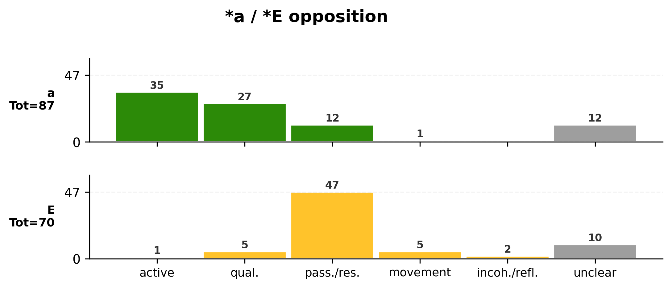
Is this really a morphological opposition?

Slide 26
Is this really a morphological opposition?
➤ *a : primarily active/qual.
➤ *E : primarily pass./res
+/- External Agent

Slide 27
Is this really a morphological opposition?
- [S] ⲟⲩⲏⲏⲃ |wéːb| : 'priest' < 'one who purifies himself' ?
- [S] ⲥⲣⲙⲉ |sᵊrmɛ́| : 'wander', 'vagrant'
< 'one who moves away'
- [S] ⲙⲏⲏϣⲉ |méːšə| : 'troops', 'crowd'
< 'those who march'
- [F] ϫⲉⲛϯ |čɛ́ntɨ| : 'wrath'
- [S] ⲥⲛⲁⲧ |sᵊnat| : 'feat', 'to be(come?) afraid'
➤ *a : primarily active/qual.
➤ *E : primarily pass./res

Slide 28
Is this really a morphological opposition?
- [S] ⲟⲩⲏⲏⲃ |wéːb| : 'priest' < 'one who purifies himself' ?
- [S] ⲥⲣⲙⲉ |sᵊrmɛ́| : 'wander', 'vagrant'
< 'one who moves away'
- [S] ⲙⲏⲏϣⲉ |méːšə| : 'troops', 'crowd'
< 'those who march'
- [F] ϫⲉⲛϯ |čɛ́ntɨ| : 'wrath'
- [S] ⲥⲛⲁⲧ |sᵊnat| : 'feat', 'to be(come?) afraid'
cf. German werden :
kalt werden : 'to become cold'
vs
gemacht werden : 'to be made'
➤ *a : primarily active/qual.
➤ *E : primarily pass./res
+/- Change of State

Slide 29
Conditioning factors?
But then:
if ⲏ and ⲓ are allophones of one proto-vowel, what are the conditioning factors?
It does not depend on the nature of the “strong” consonants of the root, as each grammatical form consistently shows the same vowel across different roots.

Slide 30
Conditioning factors?
Rather, the conditions seem to relate to:
➤ To the form of the root and the possible presence of “weak” consonants
3 strong consonants vs less than 3 strong consonants
[S] ϣⲙϣⲏⲧ= |šᵊmšét=| vs [S] ⲙⲉⲣⲓⲧ= |mᵊrít=|
➤ To specific morphological forms
With ⲏ
- Pseudoparticiples
- Deverbal feminine nouns *CVCCV́ỷVt / *CVCV́CVt
With ⲓ
- CⲓCⲉ action nouns
- Nisba
- -Cⲓⲧ= imperatives

Slide 31
Conditioning factors?
In some cases, post-tonic vowels can be reconstructed/assumed through comparison
When these vowels are considered, a pattern emerges:
With ⲏ
- Pseudoparticiple 3SG.M: *=a
*CÉCCa
- Feminine suffix: *-at *CVCCÉỷat / *CVCÉCat
With ⲓ
- CⲓCⲉ Action Nouns suffix: -Et *CÉCCEt
- Nisba suffix: -Eỷ (cf. Sem. *–iy) *CVCÉỷtEỷ
➤ with postonic *a ?
➤ with postonic *E ?

Slide 32
Some rules
The following rules can be suggested:
1. *É becomes ⲓ |i| before unstressed *E
2. *É becomes ⲏ |e| before unstressed *a
3. *É becomes ⲏ |e| in the environment -CÉC= when the root has three strong consonants
4. *É becomes ⲓ |i| in the environment -CÉC= when the root has less than three strong consonants (i.e. has at least one weak consonant)
⚠️ This is an open set of rules that explain the forms that have been analysed in this study. Additional rules might exist for other cases (e.g. deverbal nouns of "weak" roots etc.)

Slide 33
Some rules
These rules provide a solution for the issue of the apparent ⲏ > ⲓ in the Nisba :
With ⲏ + postonic *a
- [L] ⲙϩⲏ |mᵊhé| < *mVḥÉỷat
'northwind'
With ⲓ + postonic *E
- [S] ⲙϩⲓⲧ |mᵊhít(ᵊ)| < *mVḥÉỷtEỷ
'north'

Slide 34
The bigger picture
How does this two-vowel system fit within Afro-Asiatic?
➤ Similar to what is reconstructed for Chadic languages and observed in Berber languages: Saharan areal feature?
➤ Is this a secondary development, a simplification of a more complex vocalic system (3+ vowels), or the "original" system?
➤ Pre-Coptic Egyptian shows widespread palatalization and labialization (already in Old Egyptian), with no clear conditioning under a three-vowel model. Two-vowel systems are often associated with consonantal palatalization and labialization. Could this also have been the case in Egyptian?

